Slide 1
Chapter 4
Where Are Programs and Data Stored?

Slide 2
Types
Main memory
RAM and ROM
Transitory vs. permanent
Files and their organization
Virtual memory

Slide 3
Main Memory
RAM
Random Access Memory
Accessing any byte as fast as any other in any order
There is sequential access memory: tape, CDs, DVDs
Read and write
Dynamic RAM most popular
Data for the CPU, I/O, etc. must be here

Slide 4
“Main” Memory
ROM
Read Only Memory
Well, mostly as can be “flashed” -- upgraded
Not really used for what most people consider main memory
Typically used for BIOS (Basic I/O System)
Holds the instructions that are executed before an OS is loaded
Holds hardware configuration

Slide 5
Transitory vs. Permanent
Registers, cache, RAM all lose values when power is lost
Registers and cache often static RAM
Must be backed by permanent storage
Typically the disk for data and sleep image
“Permanent” – disks, flash, CDs, DVDs, SSDs, SDs

Slide 6
You’re Not Alone
No one is an island – John Donne
One chimpanzee is no chimpanzee – Robert Yerkes
One disk is no disk – Beaty
Always RAID and backup
Notes:
https://en.wikipedia.org/wiki/Robert_Yerkes

Slide 7
Permanent
Write once
Silver CDs and DVDs
Write occasionally
BIOS
Re-recordable CDs and DVDs
Write often
Camera cards
Flash

Slide 8
Permanent
Write all the time
Spinning disks
SSDs
All have a limited lifetime (usu. measured in read/write cycles)

Slide 9
Files
Basic unit of storage
A set of related data
CDs, DVDs
One track, sequential access
Variable speed

Slide 10
Spinning Disks
Organized into tracks, sectors (sometimes blocks, typically 512 bytes), heads, cylinders
Rotational latency
Based on RPM
Seek latency
Based on speed of arms
Optimize for sequential and cylinder

Slide 11
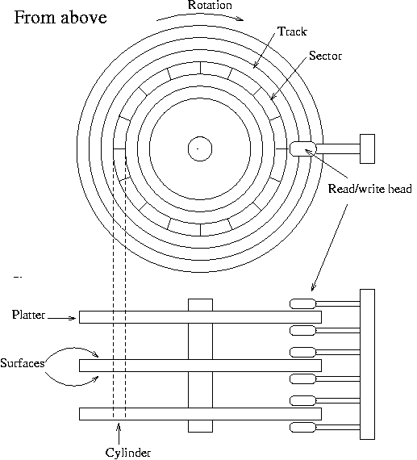
Picture
Notes:
http://www.tldp.org/LDP/sag/html/hard-disk.html

Slide 12
Files
Organized into directories or folders
And sub-directories
Form a tree rooted at the top-level directory
Directories hold pointers or references to file structures

Slide 13
File Structure
Can have a file in linear set of sectors
Start and count
Have to find large enough linear space
Inflexible
Can have list of sectors
In an array
In a linked list
One sector has next sector number at the end

Slide 14
Linked List

Slide 15
FAT
Array of sectors
N > 0 – sector
N = 0 – EOF
N < 0 – free
Directories refer to list of starting sectors
Sector size 4K

Slide 16
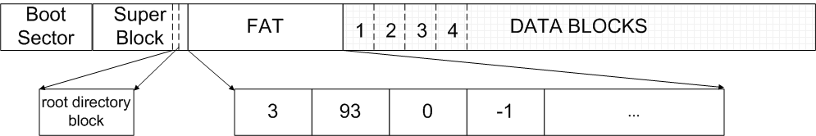
File Access Table
Notes:
http://web.cs.ucla.edu/classes/spring09/cs111/scribe/12/index.html

Slide 17
Li/Unix
Inodes
Information nodes
Sector size 8K
Can have “holes”
Does not contain file name
Can be linked in multiple directories via links

Slide 18
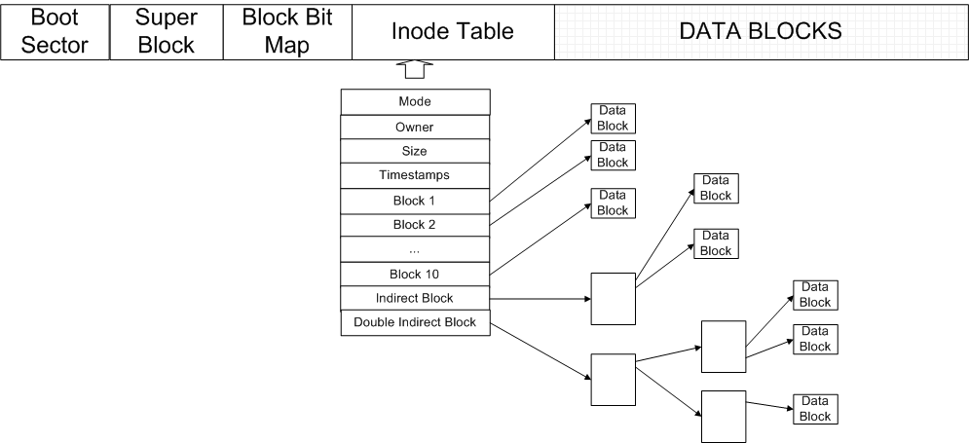
Li/Unix

Slide 19
The Need for Speed
Type | Typical Access Time | Capacity
Registers | 1 ns | < 1000 bytes
Cache | 2 ns | 4MB
Main memory | 100 ns | 8192 MB
SSD | 1,000,000 ns | 1,000,000 MB
Disk | 10,000,000 ns | 1,000,000 MB
Notes:
https://gist.github.com/jboner/2841832

Slide 20
Humans
190,000,000 ns to detect visual stimulus
Notes:
https://en.wikipedia.org/wiki/Mental_chronometry

Slide 21
Progress
Read initial instructions and data from disk to main memory
Move instructions and data to/from registers and main memory
Write results out

Slide 22
Virtual
Main memory not large enough to hold all data
For all the running programs
Disk acts as backing store
Has a swap file or file system
Memory cache for disk

Slide 23
Virtual
Virtual in the sense of not real (physical)
Memory appears to be bigger than it is
Abstraction
Used a lot to hide details
Program and data broken in pages
Pages brought in and out as needed
Paging algorithm
Least recently used, etc.

Slide 24
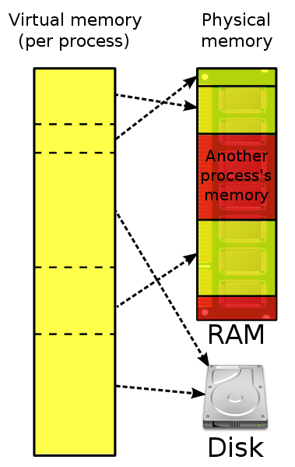
Virtual Memory

Slide 25
Thrashing
If working set of programs larger than main memory
A lot of time used for paging
Do less or buy more memory

Slide 26
Cache
Similar
Broken into “lines”
Not seen by the CPU
CPU sends addresses and if in cache, memory reference “squashed”
Translation look-aside buffer (TLB)
Also has algorithm to choose which parts of main memory to keep resident

Slide 27
Fragmentation
Internal
Within a file, page, etc.
External
Outside of files
Slows access as files become less contiguous
Have to do a lot of seeking

Slide 28
Defragment
Moves file sectors next to each other
Takes a while
Some file system types less susceptible
Possible performance gain of 30 – 90% for highly fragmented file system

Slide 29
How Much Memory is Enough
There’s never enough
Go big on memory
CPU speed less an issue typically
Go big on disks too
Programs grow to fill memory
New programs
New versions
Have to upgrade at some point for interoperability and support

Slide 30
OS Size
MS-DOS: 4000 lines
Windows NT: 6,000,000 lines
XP: 40,000,000
Windows 7: 50,000,000
Unix similar

Slide 31
Trash
Move a file to trash just moves directories
Emptying trash just removes directory reference (deletion)
Sectors reused for new files
But data still visible until overwritten
Data might be able to be retrieved
Erasure
Data overwritten immediately

Slide 32
Real Erasure
Several passes with different data patterns

Slide 33
Other Pesky Files
Configuration files
Stored thumbnails
History of edits
Automatic backup copies
All these might take some looking as they are typically “hidden”

Slide 34
Further Study
Questions: 1, 2, 5, 6, 10
Exercises: 3, 5, 7, 8

